Slide 1
Architecture of IoT Platform
2015.06.26.
Team 5

Slide 2
Agenda
Project Context
Architectural Driver
System Context
Views
Detail Design
Test
Project plan & Time log

Slide 3
Project Context
Business Context
Strategy
Building “IoT Ecosystem Infrastructure” to provide benefits to stakeholders.
. Easy installation for IoT nodes
. Utilizing cost competitive IoT products
Future direction
Provide a standard framework to facilitate 3rd party application development
Support future data mining & analysis
Profit Model
Receive fee from the app. developer according to their permission of access level
The expansion of ecosystem brings more profits
Market Context
Time to market
This product should be developed and delivered within 5 weeks.

Slide 4
Project Context
Technical Context
Should support machine-to-person interaction model(M2P) and machine-to-machine(M2M) interaction models.
The system has to support IoT nodes at least 10 years.
Privacy and security are required considerations for IoT Environment
System should make it easy to add emerging protocols.
Elements | Terminal | System | SA Node
Device Type | Mobile and PC | Server (PC) | Sensor, Actuator
Language | Java | Java | Arduino Language
Development Tools | Eclipse IDE | Eclipse IDE | Arduino IDE

Slide 5
Project Context
Organizational Context
The team is composed with 6 members
Design : all together
Test and verification : each member who developed the component will do unit test and verification
Integration test : all together
Responsibility
Organizational Culture
Members will be responsible and accountable for their individual area.
Stand-up meeting at each day before starting work.
Facilitate collaboration and team building through group lunch approach.
Work 5 days a week for 5 weeks
Management
Jongsoo Oh
Architectural Design
Architectural Design
Developer(Server)
Developer(Node)
Developer(Terminal)
Jinsuk Oh
Hoejung Yun
Youngsoo Choi
Sangjun Jung
Swapan Pati

Slide 6
Architectural Driver
Functional Requirement (1/2)
ID | Requirement | Description
R-01 | Control SA Nodes | Users can determine the temperature/humidity, turn on and off lights, open and close the door, turn on the alarm, and determine if anyone is home.
R-02 | Give the information about installed Nodes and sensors/actuators | User can get the information how many nodes are installed at the system and what sensors/actuators are installed on each node.
R-03 | Store the sensor value of node | System should store sensor values.
R-04 | Store log for user commands | System should log all user commands.
R-05 | Review stored data | User should review their sensor and command history.
R-06 | Send emergency message | The system should send an emergency message when the door is manually opened while alarmed or the house is suddenly occupied while alarmed.
R-07 | Disable door opening automatically | The system should not allow automatic door opening while the house is alarmed. The alarm must be disabled prior to opening the door.

Slide 7
Architectural Driver
Functional Requirement (2/2)
ID | Requirement | Description
R-08 | Support alarm message | The system should send a message to the user to inform them when the house is vacant and not alarmed.
R-09 | Ask for alarming home | When the house is vacant and not alarmed the system should ask users if they want to alarm the home.
R-10 | Locking automatically | When the house is vacant and not alarmed and the user do not respond within 5 minutes, the house will lock itself and close the door if opened.
R-11 | Automatically turn off the light | The system should automatically turn off the lights when no one is home and 10 minutes elapses.
R-12 | Add/Remove SA Node | Users can add and remove nodes the system without having to restart the system or other nodes

Slide 8
Architectural Driver
Quality Attribute
ID | Priority | Description | Attribute
QA-01 | High | Installer can add and remove nodes to the system easily. | Usability
QA-02 | Medium | System will be available always to do any IoT Based Operations | Availability
QA-03 | High | Do not allow unauthorized persons to register a sensor | Security
QA-04 | Medium | Only the authorized person can access the home sensors/actuators or access any data generated by them, or any data stored in the system. | Security
QA-05 | Low | The system should store sensor values and log all user commands for some period of time | Reliability
QA-06 | High | The system should make it easy for application developers | Extensibility
QA-07 | Medium | The system should make it easy to add emerging protocols | Modifiability

Slide 9
Architectural Driver
Business Constraints
Technical Constraints
Consideration | Description
Schedule limitations | All features of functional requirements list should be implemented by 26th June.
Consideration | Description
Computer language(s) | The system only permits Java language.
Logistical Issues | The system should store sensor values and log all user command, and time limitation is up to max. 72 hours.
Communication | CMU Network should be always available

Slide 10
System Context
Project scope
Server
Home Security
Node
Terminal
Mail Box
Node
Node
Terminal
vendors
3rd party
SA node
Terminal
SA node
Terminal

Slide 11
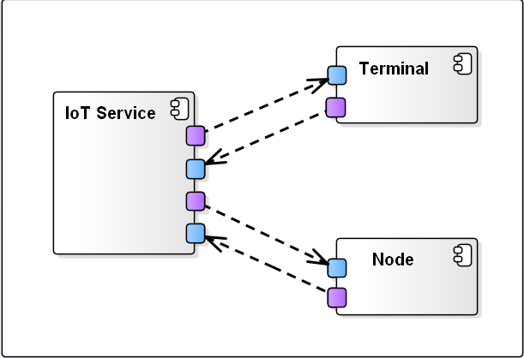
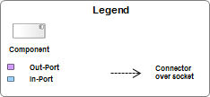
Architecture Design - Level 1 - Apply Server-Client pattern for loose coupling
Rationale :
In view of SRP (Single Responsibility Principle), we divided the responsibility (loose coupling) into three Elements (IoT Service, Node & Terminal).
Message Exchange Pattern (MEP) of Server-Client Pattern has been considered for interaction between Elements. In MEP, we have considered “Request-Response Pattern” over “One-Way Pattern” because “IoT Service” has to Response based on “Terminal”/”Node” Service Request.
Notes:
Rationale : SRP(Single Responsibility Principle)을 고려하여 Element를 IoT Service, Node and Terminal로 나누어 Element간의 loose coupling되도록 설계하고, Element간의 상호 작용 시에도 coupling을 줄이기 위하여 message를 통하여 상호 작용하는 방법으로 설계하기 위하여 Server-Client Pattern의 주요 message exchange pattern(MEP)인 request-response pattern과 one-way pattern을 alternatives 검토하였음.
Iot Service, Node and Terminal 사이에는 service request와 requested service 수행 및 그에 대한 response가 Requirements이므로 one-way pattern보다는 request-response pattern을 적용하여 IoT Service와 Node/Terminal간의 relationship을 갖도록 design decision 하였음.

Slide 12
Architecture Design - Level 1 - Responsibility Catalog
Table 1.1. Element Responsibility Catalog for the First-Level Decomposition
Associated Drawings: Figure 1 | Perspective: Dynamic
Element | Responsibilities
Iot Service | Iot Service act as a Server & is responsible to Interact & manage the Clients(Node & Terminal)
Node | Node act as a Client & responsible for Node core operation. It has to process/response Iot Service command
Terminal | Terminal act as a Client & responsible for Terminal core operation. It has to process/response Iot Service command

Slide 13
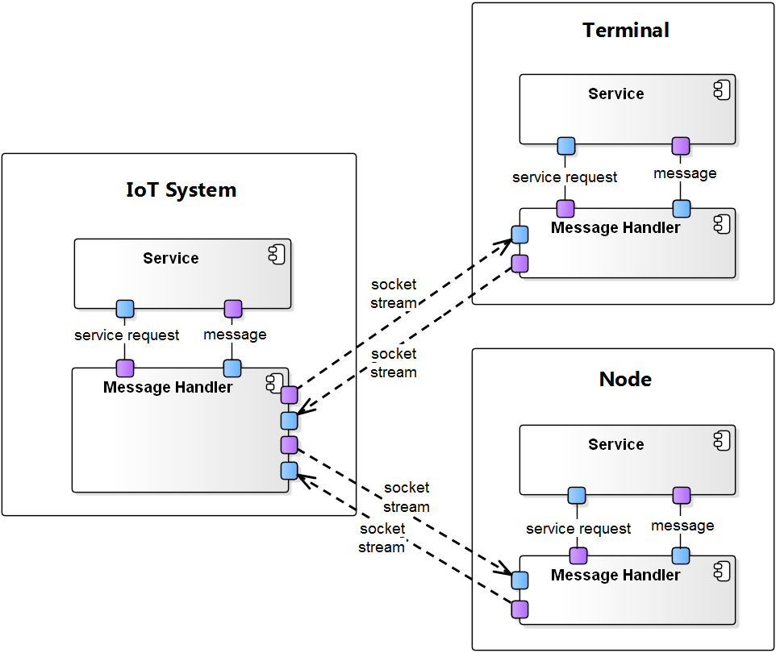
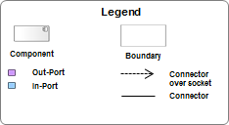
Architecture Design - Level 2 - Apply Layered Architecture Pattern For QA6
Rationale:
In Level-2 we have decomposed the elements further by considering the QA6 (Extensibility).
In Level-1 “Request-Response Pattern”, abstracting the external relationship, here applied “Layered Pattern” where “Handler” will interact with respective Elements Services (Internal relationship) whereas; same Handler will do External Elements Interactions.
Handler will be in Library form (Hide the Data Marshaling/Un-marshaling & Security) for Message External Interaction (Protocol based), with this ensuring the ease of development for Node & Terminal
Notes:
Rationale:
QA6에서 도출된 The system should make it easy for application developers를 IoT service 의 extensibility 확보 하기 위해서 약속된 규약(Protocol)을 통한 message 전송과 수신을 할 수 있는 부분을 독립적으로 구성
이는 앞에서 언급한 Request–response pattern을 적용하여 대외적인 관계를 추상화하여 처리한 수 있음
그리고, Layered architecture pattern을 적용하여 각자의 지원 기능인 Service와 상호작용을 위한 Message Handler의 역할을 restrict dependency를 추구할 수 있음
대내적으로는 Message handler 부분을 Library 형태로 지원하여 node & service 개발 시 service 들이 porotocol message를 자세하게 알지 않아도 개발 가능하도록 지원하여 개발용이성 확보

Slide 14
Architecture Design - Level 2 - Responsibility Catalog
Table 2.1. Element Responsibility Catalog for the Second-Level Decomposition
Associated Drawings: Figure 2 | Perspective: Dynamic
Element | Responsibilities
Service | Responsible for Process core operation apart from external data communication
Handler | Externaly, Handler is responsible for data communication with other device. Internaly, Handling the data communication via own defined protocol.

Slide 15
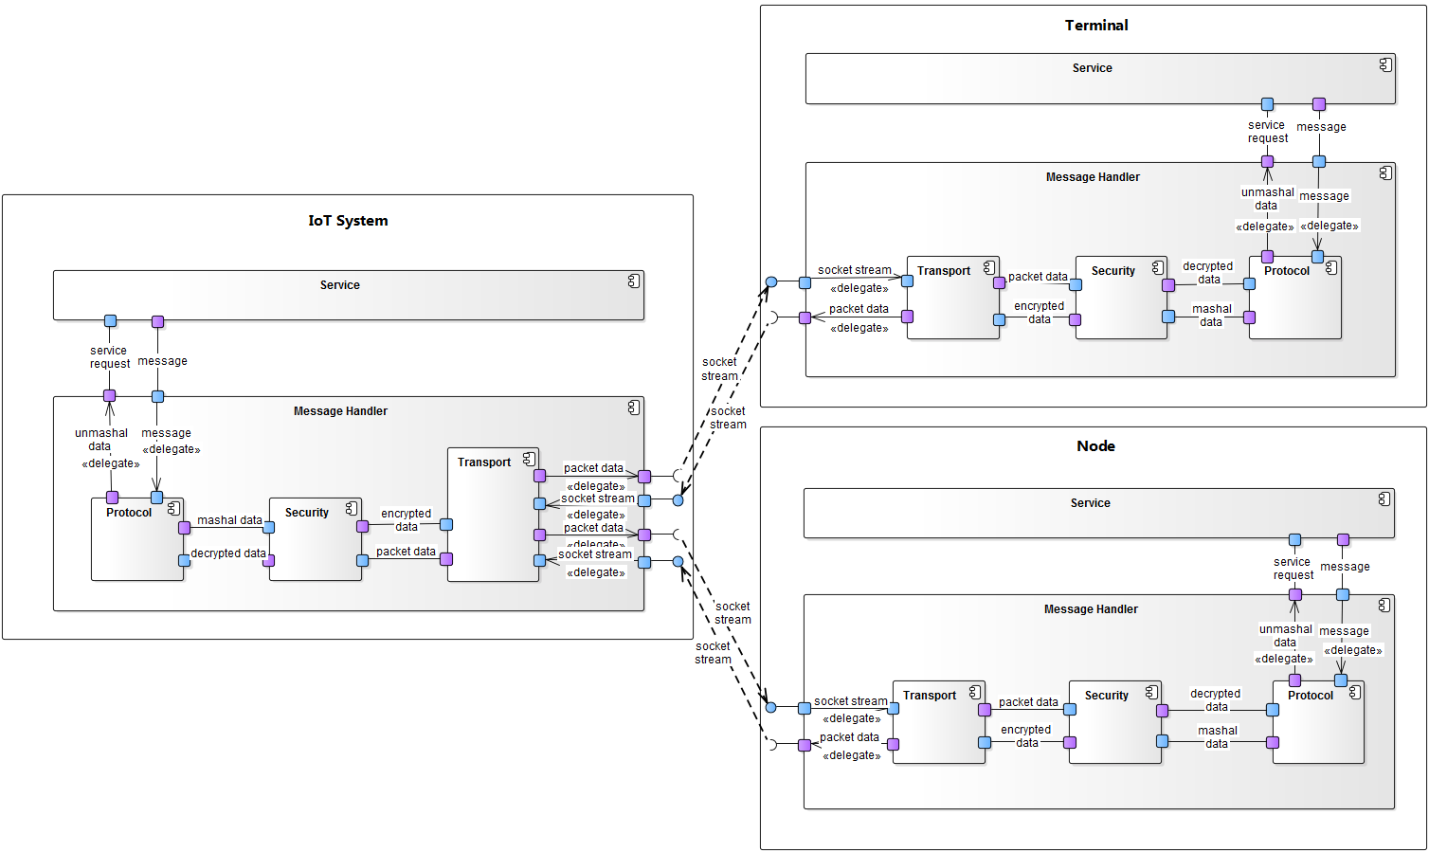
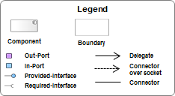
Architecture Design - Level 3 - Add component and Apply Pipe & Filter pattern for QA3,QA7
Rationale:
In level-3 decompose further by considering the QA3 (Security) & QA7 (Modifiability)
In Level-2, Handler component is made responsible for message send & receive from each Elements.
Handler decomposed further into security (Encrypt data tatic applied) component for making the robust secure system.
Handler decomposed further into Transport component for making the connection type(Socket) (WIFI, BT etc) loosely couple with the system.
Protocol component will do the data formatting (Marshaling/Un-marshaling)
By applying the component additional structurally Pipe & Filter pattern, to design decision to be easier to apply future of the new security policy applied and emerging protocol additions.
Notes:
이번 decomposition의 경우 QA3(“Do not allow unauthorized persons to register a sensor“)의 security와 QA7(“System should make it easy to add emerging protocols”)의 modifiability를 확보하기 위함
Level2의 (Message) Handler component는 각 기기의 message 송수신을 담당하게 된다.
하지만, 각 기기 간의 message 보안을 위해서 security 담당할 component를 구성
이 security component는 Encrypt data tatic을 적용하여 message 암호화를 위한 security key의 발행과 message 암호화/복호화를 지원하여 system내 message security 확보
Security component에서 복호화 된 data를 protocol component에서 반복적으로 무의미한 command 전달 시 악의적 attack 으로 간주하여 closing a port(Limit access tatic) 처리하여 system 보호함
추가적으로 WIFI socket 이 외의 다른 통신 방식을 지원하기 위해서 transport 담당할 componet를 추가적으로 구성하여 다른 통신 방식 지원할 수 있도록 함
이 transport component는 각 기기 간의 session 연결과 message 송수신을 담당
수신 시 transport component에서 받은 message를 security component에서 복호화, porotocol component에서 의미 있는 단위로 나눠 service로 전달
해당 decomposition의 경우 적용 가능한 pattern에 대해서 검토했으나 적용 가능한 pattern보다는 QA를 지원하기 위한 component 추가를 통하여 decomposition 함
component 추가와 함께 구조적으로 Pipe & Filter pattern을 적용하여 추후 새로운 security policy 적용이나 emerging protocol 적용하기 용이 하도록 design decision 함
Apply data security for making the robust system we applied the Pipe & Filter Pattern to achive it.
Apply Transport component for making the connection type(WIFI, BT etc) loosely couple with the system. In here to achive it we applied the Pipe & Filter Pattern

Slide 16
Architecture Design - Level 3 - Responsibility Catalog
Table 3.1. Element Responsibility Catalog for the Second-Level Decomposition
Associated Drawings: Figure 3 | Perspective: Dynamic
Element | Responsibilities
Service | Service is managing the core functionality of the running process.
Protocol | This component is responsible formating the message for communication.
Security | This component is responsible for incoming/outgoing data Encoding & Decoding based on project defined Encription Logic.
Transport | This is responsible for making the data external communicaiton with barrier(WIFI, BT etc) independent & loose couple

Slide 17
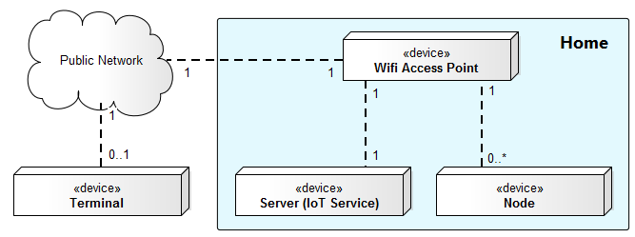
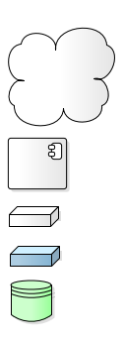
Architecture Design - Level 3 - Switch to physical perspective
Rationale:
Security 강화와 infrastructure 비용 감소를 위해서 Server의 위치를 Home network 안쪽으로 결정함
사용자 log와 login에 대해서 local로 관리하기 때문에 외부에 server가 있는 것보다는 security 확보 가능
AP에 Server를 Embedded하는 것도 고려 가능하며, 이러한 경우 Cost 절감 효과를 가질 수 있음.
Legend
Network
Device
Component
Part of device
Database storage

Slide 18
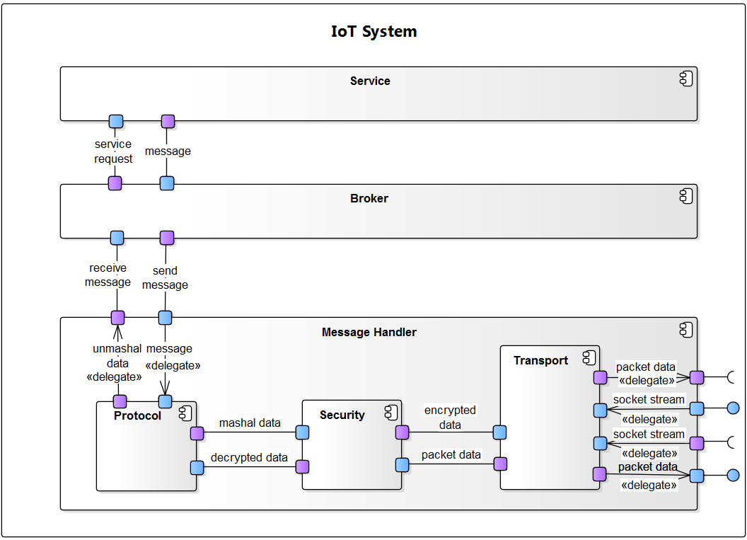
Architecture Design - Level 4 - Broker Pattern for QA1
Rationale:
In Level-4, we have decomposed further by considering QA1 (Usability). Easy Node Registration/Un-Registration procedure simple in order to satisfy the design, Interaction between IoT Service and Node/Terminal we used Broker Pattern.
Broker is hide the data flow Transparency(ignorant of the identity,location & characteristics) so its easy for user to do Registration/Un-Registration with minimal steps & indirectly benifit for the developer.
We considered Broker Pattern because it allows message ordering and the guarantee of message delivery in the Broker, be applied in conjunction with the applied Server-Client Pattern of MEP (Message Exchange Pattern) from Level 1 and a more effective to design decision that is to apply the decision to Broker Pattern
Notes:
QA1(“Easy Node Registration/UnRegistration”)에서 도출된 Usability를 만족시키기 위하여 Node Registration/Unregistration 절차가 간단하고 복잡하지 않도록 IoT Service, Node/Terminal간의 상호작용을 간단하게 design해야 할 필요성이 있으며, 이를 위하여 Broker Pattern과 Publish-Subscribe Pattern을 alternatives로 검토 하였음.
Publish-Subscribe Pattern의 경우 Less control over ordering of messages, delivery of message is not guaranteed등의 약점이 있으며, Broker Pattern의 경우 Terminal과 Node 상호작용 시에 직접적이 아닌 Broker를 통하여 상호작용을 하므로 Location Transparency의하여 상호작용 절차가 간단해 질 수 있는 장점이 있음.
또한 Broker Pattern에서는 Broker에서 message ordering 및 guarantee of message delivery가 가능하므로 Level 1에서 적용된 Server-Client Pattern의 MEP(Message Exchange Pattern)과 함께 적용하는 것이 좀 더 효과적인 것으로 판단하여 Broker Pattern을 적용하는 것으로 design decision 함.

Slide 19
Architecture Design - Level 4 - Responsibility Catalog
Table 4.1. Element Responsibility Catalog for the Second-Level Decomposition
Associated Drawings: Figure 4 | Perspective: Dynamic
Element | Responsibilities
Broker | Broker is an intermediary which receives a message from the sender(Terminal or Node) and routes a message to proper destination(Terminal or Node).

Slide 20
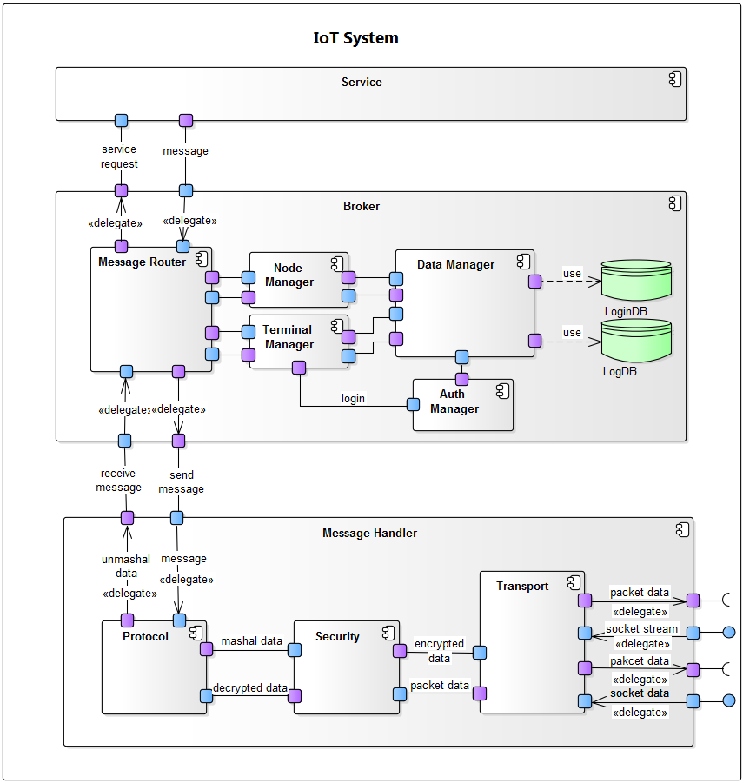
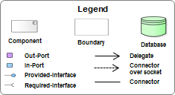
Architecture Design - Level 5 - for QA4
Rationale:
All Messages that have been transmitted from the Broker in consideration of the fact that it can be processed and is transferred to the Node / Terminal, Node / Terminal can be added/remove Runtime in the operating environment that can be the take the control in mind, by applying the Publish-Subscribe Pattern we decomposed into Node Management, and Terminal Manager.
In considering QA4 “Only the authorized person can access the home sensors / actuators or access any data generated by them, or any data stored in the system." It is in the Security Tactics for Security Attack in order to satisfy the Security that has been derived in Resist Attacks Tactics of Identify Actors, Authetificate Actors, in order to achive it, we added an Auth Manager component, so only Authorize persons will allowed to access the system
Notes:
Broker로부터 전달받은 Message를 모든 Node/Terminal로 전달하여 처리 될 수 있음을 고려하고 Node/Terminal이 Runtime시에 add/remove될 수 있는 동작 환경에서도 Node/Terminal에 Message전달/처리가 되어야 함을 고려하여 Publish-Subscribe Pattern을 적용하여 Node Mgr, Terminal Mgr를 추가 함.
QA4의 “Only the authorized person can access the home sensors/actuators or access any data generated by them, or any data stored in the system.”에서 도출된 Security를 만족하기 위하여 Security Attack에 대하여 Security Tactics 중에서 Resist Attacks Tactics의 Identify Actors, Authetificate Actors, Authorize Actors를 적용하기 위해 Component(Auth Mgr)를 추가하여 Terminal의 Login, Permission 관리를 하도록 함

Slide 21
Architecture Design - Level 5 - Responsibility Catalog
Table 5.1. Element Responsibility Catalog for the Second-Level Decomposition
Associated Drawings: Figure 5 | Perspective: Dynamic
Element | Responsibilities
Node Manager | Managing the Node Informations (Registred Node Details, Node Data (Sensors, Acturators & Services)
Terminal Manager | Managing the Terminal Information (Logged In Terminal Details)
Auth Manager | Responsible for validating the Terminal user details & generate the session Key for valid connected users.Managing the session for active connection
Log DB | Repository for keeping all connected Node data (Sensors data) as well as Terminal command (Actuator Actions) history
Login DB | Keeping all Registred Users (Terminal) Login User ID & Password Details

Slide 22
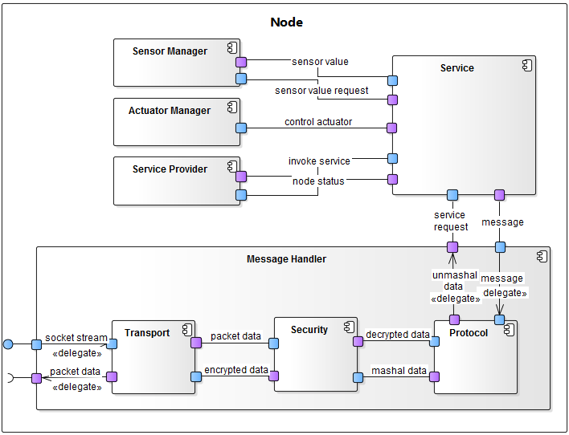
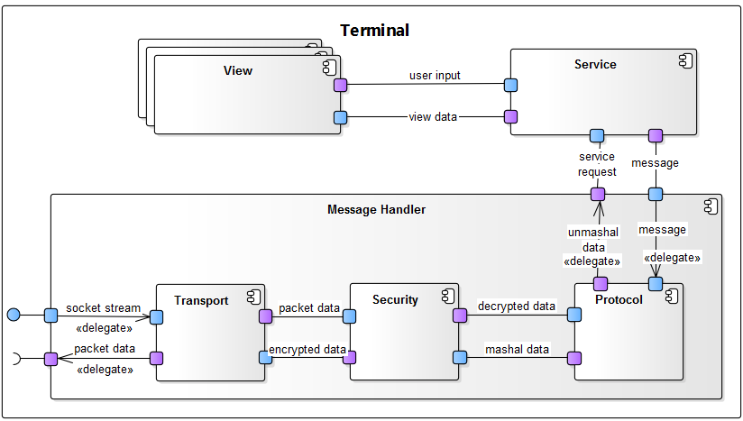
Architecture Design - Level 6 - Node & Terminal Decomposition
Rationale
Considering the Functional requirement, added components for the specific behavior of the Terminal & Node.
Terminal applies the MVC pattern, individually View component to support the user's UX setting by this, minimize the impact of change on UX change.
The main function of Node divided to Node Sensor / Actuator / Service is, added to the Single Responsibility Principle applied separate component in a separate responsibility. Thus, 3rd party node developer, since it is sufficient to develop only the necessary component development, easier to develop
Notes:
Terminal과 Node의 경우 기존에 분리된 Protocol, Security, Transport component 즉 Message Hanlder를 공유하며 이를 통해 안정적이고 보안이 유지된 message 송수신 할 수 있음
이와 함께 Terminal과 Node의 고유의 동작을 위한 component 추가
Terminal은 MVC pattern을 적용하여 사용자의 UX를 지원하기 위한 View component를 독립적으로 구성
이를 통해 UX변경 시 변경 영향도 최소화
Node의 주요 기능인 Sensor/Actuator/Service는 개별적 기능으로 Single Responsibility Principle 적용 분리된 component로 추가
이를 통해 3rd party node 개발자들은 개발이 필요한 component만 개발하면 되기 때문에 개발 용이

Slide 23
Architecture Design - Level 6 - Responsibility Catalog
Table 6.1. Element Responsibility Catalog for the Second-Level Decomposition
Associated Drawings: Figure 6 | Perspective: Dynamic
Element | Responsibilities
View | Responsible for User Input & data presentation (Specially for UI scenerio)
Sensor Manager | Responsible for Handling the connected Sensors into the Node
Actuator Manager | Responsible for Handling the connected Actuators into the Node
Service Provider | Responsible for providing servie such as data mining and actutor handling.

Slide 24
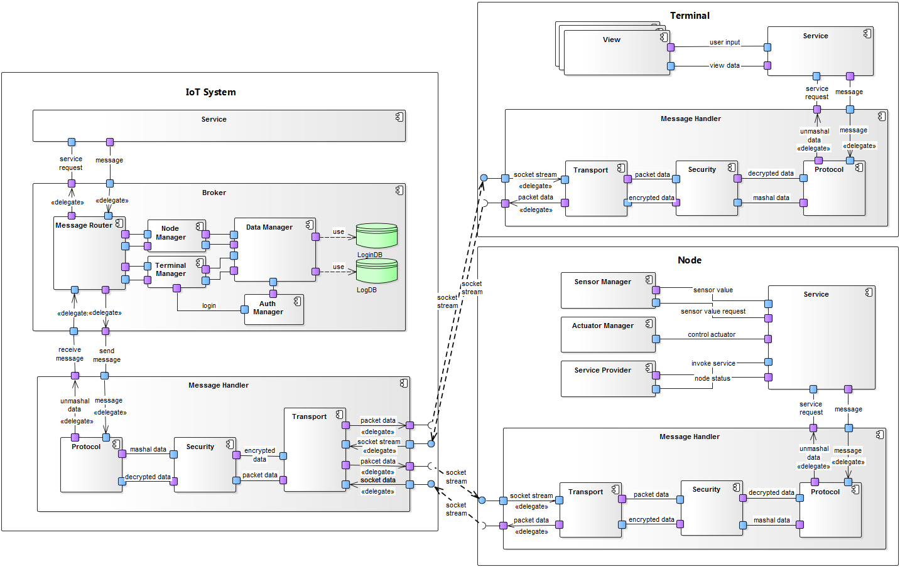
Architecture Design - Final dynamic perspective

Slide 25
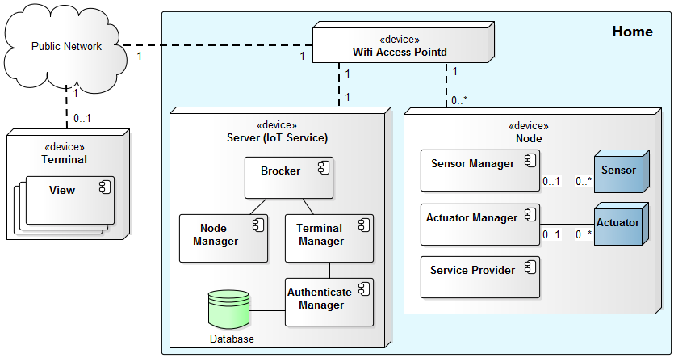
Architecture Design - Final physical perspective
Legend
Network
Device
Component
Part of device
Database storage

Slide 26
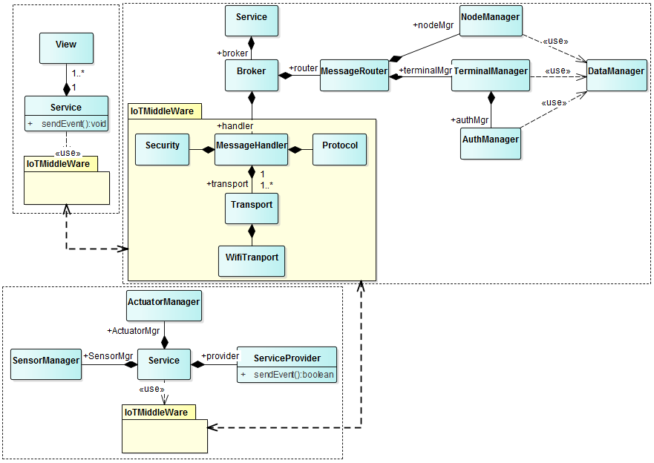
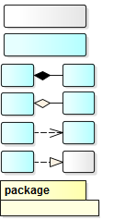
Architecture Design - Final static perspective
Terminal
IoT service
Node
Legend
Interface
Class
A
B
Composition
A
B
Aggregation
A
B
Use
A
B
Realize
IoTMiddleWare

Slide 27
Detail Design

Slide 28
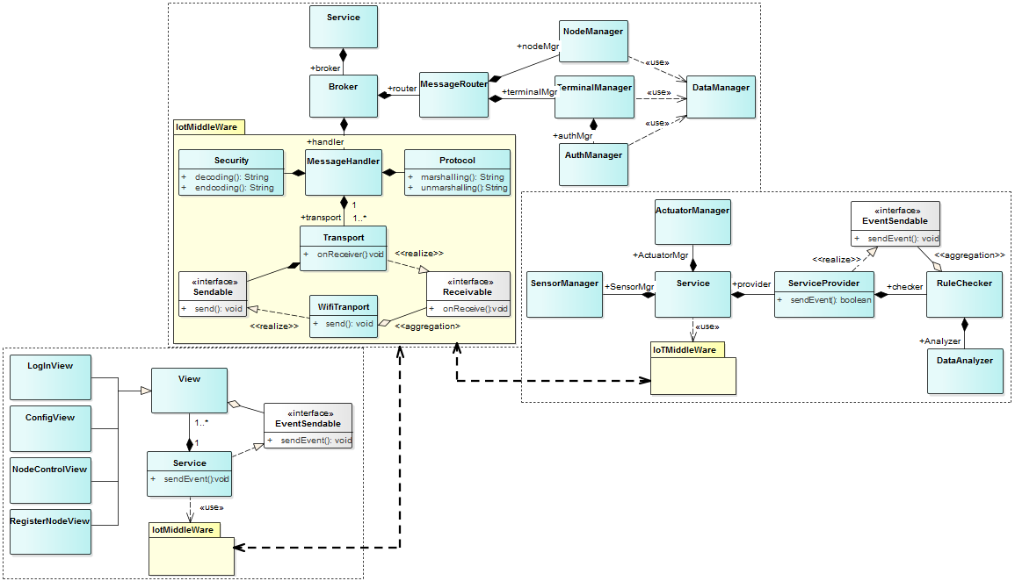
Detail Design
IoT service
Node
Terminal
Legend
Interface
Class
A
B
Composition
A
B
Aggregation
A
B
Use
A
B
Realize
Package

Slide 29
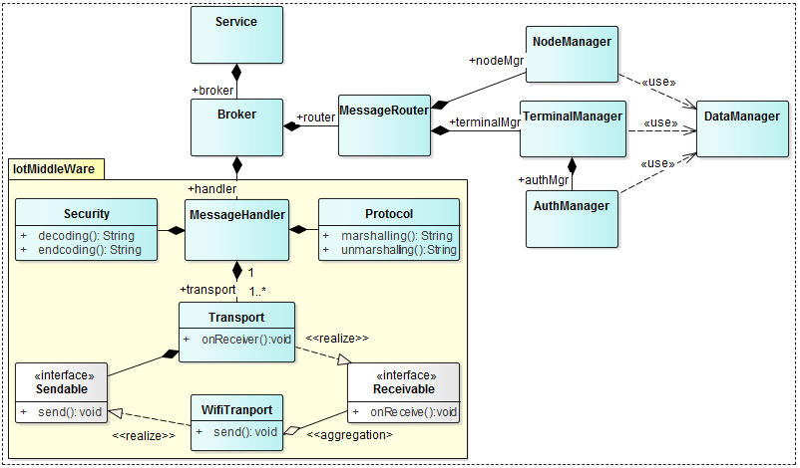
Detail Design - IoT Service
Legend
Interface
Class
A
B
Composition
A
B
Aggregation
A
B
Use
A
B
Realize
Package

Slide 30
Detail Design - IoT Service(Responsibility Catalog) #1
Table D1. Element Responsibility Catalog for detail design
Associated Drawings: Figure 3 | Perspective: Static
Element | Responsibilities
Service | Service is managing the core functionality of the running process.
Brocker | Broker is an intermediary which receives a message from the sender(Terminal or Node) and routes a message to proper destination(Terminal or Node).
MessageRouter | MessageRouter is managing the Message Routing table which will transfer the messages to intended elements (NodeManager, TerminalManager) after getting from Broker & vice versa.
NodeManager | Managing the Node Informations (Registred Node Details, Node Data (Sensors, Acturators & Services)
TerminalManager | Managing the Terminal Information (Logged In Terminal Details)
AuthManager | Responsible for validating the Terminal user details & generate the session Key for valid connected users.Managing the session for active connection
DataManager | Managing the database operatation. Keeping the DB Abstarction from NodeMangaer,TerminalManager & AuthManager.
MessageHandler | Responsible for Overall IotMiddleware management. Handling the message filteing from network to protocol (Transport<-->Security<-->Protocol) & Transfer the filtered message to Service for operation
Protocol | This component is responsible formating the message for communication.

Slide 31
Detail Design - IoT Service(Responsibility Catalog) #2
Table D2. Element Responsibility Catalog for detail design
Associated Drawings: Figure 3 | Perspective: Static
Element | Responsibilities
Security | This component is responsible for incoming/outgoing data Encoding & Decoding based on project defined Encription Logic.
Transport | This is responsible for making the data external communicaiton with barrier(WIFI, BT etc) independent & loose couple
WifiTransport | Managing the Wifi Socket operation(open/close socket, read/write operation )

Slide 32
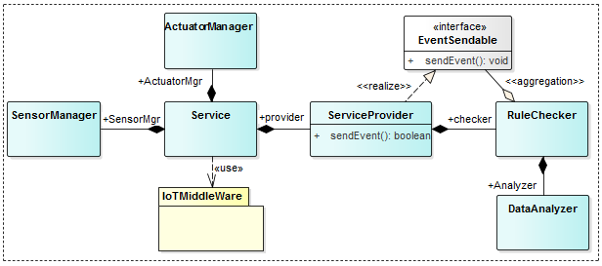
Detail Design - Terminal
Legend
Interface
Class
A
B
Composition
A
B
Aggregation
A
B
Use
A
B
Realize
Package

Slide 33
Detail Design - Terminal(Responsibility Catalog)
Table D3. Element Responsibility Catalog for detail design
Associated Drawings: Figure 3 | Perspective: Static
Element | Responsibilities
Service | Service is managing the core functionality of the running process.
SensorManager | Responsible for Handling the connected Sensors into the Node
ActuatorManager | Responsible for Handling the connected Actuators into the Node
ServiceProvider | Responsible for providing servie such as data mining and actutor handling.
MessageSendable | Message를 server로 전달 할 수 있는 interface
RuleChecker | Service에 대한 rule을 check하는 루틴으로 dataAnalyzer를 통해서 정제된 data를 통해 원하는 rule이 만족될 경우 그에 대한 message를 생성 및 전달
DataAnalyzer | Log나 command에 대해서 받아서

Slide 34
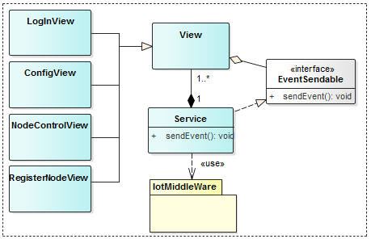
Detail Design - Node
Legend
Interface
Class
A
B
Composition
A
B
Aggregation
A
B
Use
A
B
Realize
Package

Slide 35
Detail Design - Node(Responsibility Catalog)
Table D4. Element Responsibility Catalog for detail design
Associated Drawings: Figure 3 | Perspective: Static
Element | Responsibilities
Service | Service is managing the core functionality of the running process.
View | Responsible for User Input & data presentation (Specially for UI scenerio)
LoginView | Responsible for User login (UI)
ConfigView | Responsilbe for Node & Server Remote Configuration (Like, Log Store Duration, Lighs Auto switch-off duration etc)
NodeControlView | Responsible for Remote Node Control Operation (UI)
RegisterNodeView | Resposible for New Node Registration & Existing Node UnRegistration (UI)

Slide 36
Detail Design – Sequence diagram
Node registration
Service:Terminal
Broker:Server
Node manager:Server
Node manager:Server
Request register
Request register
Check new node
Find new node
Request register
Check serial
Node information
Node information
Register confirm
Register confirm

Slide 37
Detail Design - Protocol
Command | Sender | Intermediacy | Receiver | Value
Certificate user
Request login | Terminal |  | Server | ID/PW
Confirm login | Server |  | Terminal | Success or Fail
Register node
Request registration | Terminal | Server | Node | serial
Confirm registration | Node | Server | Terminal | (success, nodeinfo) or (fail, reason)
Confirm registration | Server |  | Terminal | fail, reason
Get node value
Get node value | Terminal |  | Node
Node value response | Node |  | Server | node value
Node value response | Server |  | Terminal | All node value

Slide 38
Detail Design - Protocol
Command | Sender | Intermediacy | Receiver | Value
Unregister node
Request unregistration | Terminal | Server | Node | nodeId
Confirm unregistration | Node | Server | Terminal | Success or Fail
Control acturator
Control acturator | Terminal | Server | Node | nodeId, name, value
Confirm control | Node | Server | Terminal | success or fail
Request logs
Request logs | Terminal |  | Server
Confirm logs | Server |  | Terminal | logs
Set alarm
Ask to set alarming | Node | Server | Terminal
Set alarm | Terminal | Server | Node | yes or no

Slide 39
Detail Design - Protocol
Command | Sender | Intermediacy | Receiver | Parameter
Send message
Send message | Node | Server | Terminal | (emergency, reason) or (normal, reason)
Set alarm timer
Set alarm timer | Terminal | Server | Node | time

Slide 40
Detail Design – Mata data
Certificate user
Register node
Confirm
1st level | 2nd level | Type | value
messageType |  | string | register, etc
id |  | srring
password |  | string
1st level | 2nd level | Type | value
messageType |  | string | register, etc
serial |  | number
1st level | 2nd level | Type | value
messageType |  | string | register, etc
result |  | srring | success or fail
reason |  | string

Slide 41
Detail Design – Mata data
Node information
1st level | 2nd level | Type | value | Command
messageType |  | string | register, etc
deviceType |  | string | node or terminal
nodeName |  | string | node name
nodeId |  | number | MACAddress | last 4 digit
sensor |  | array |  | optional
 | name | string | sensor name
 | valueType | number or array | vender define
acturator |  | array |  | optional
 | name | string | acturator name
 | valueType | number or array | vender define

Slide 42
Detail Design – Mata data
Get value response
Control acturator
1st level | 2nd level | Type | value | Command
messageType |  | string | register, etc
nodeId |  | number | MACAddress
equipmentType |  | string | sensor or acturator
name |  | string | sensor or acturator name
value |  | number or string | vender define
1st level | 2nd level | Type | value | Command
messageType |  | string | register, etc
name |  | string | sensor or acturator name
value |  | number or string | vender define

Slide 43
Detail Design – Alarm status
State change
Event
Operation
Set before openning the door
secured
unsecured
Automatic door is not open
If door is opened, close door
Set alarm if anyone is home
House is vacant
Door is manually open
house is suddenly occupied
set alarm
No response during 5 min
Legend
Send emergency message
Send message
- Ask to set alarm
Alarm status
Event

Slide 44
Detail Design – Alarm status
Set before openning the door
secured
unsecured
Automatic door is not open
If door is opened, close door
Set alarm if anyone is home
the house is vacant
Door is manually open
house is suddenly occupied
set alarm
No response during 5 min
Legend
Send emergency message
Send message
Ask to set alarm
Alarm status
Event

Slide 45
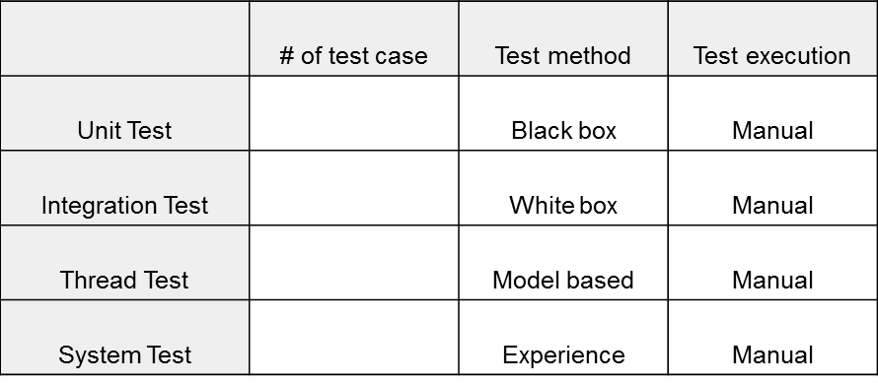
Test
Unit test
Developer has to make a test code to verify the component function & exceptional case
Integration Testing
Check the interaction between components
Thread Testing
Check the interaction between threads
System Testing
End-to-End functionality test
Functional requirement and Quality attribute have to be satisfied

Slide 46
Project plan & Time log
 | -2W | -1W | 1W(5/25~) | 2W(6/1~) | 3W(6/8~) | 4W(6/15~) | 5W(6/22~)
Schedule
output |  | Initial presentation (Draft) | Initial presentation Project Context Architect Driver Project plan Time log |  | Prototype Demo Architectural design(Draft) |  | Presentation Architectural design Detail Design Test result Time log Demo
Project analyze
Design
6/26
Final presentation
5/29
Initial presentation
6/12
Prototype demo
Implementation
Test

Slide 47
Project plan & Time log
Project resource
pre-caurse: 2 weeks, 5 members, korea
cause: 5 weeks, 6 members, CMU in USA
Resource plan
Total 672 hour works are planed
Architect: 356h(Planing, Require analysis, Design, Prototype)
Development: 181h(Detail design, Implement)
Test: 135h(component test, Integration Test)

Slide 48
Project plan & Time log
Actual resource
Total 766 hour worked(94 hours are overwork than plan)
Architect: 552h(196h more work than plan)
Especially decomposition in design takes long time
Development: 148h(Detail design, Implement)
Test: 66h(69h less work than plan)

Slide 49
Future plan
Emerging protocol
Bluetooth protocol will be supported by next handler release
Service provider for system stability
IoT server

Slide 50
Lessons & Learned

Slide 51
Appendixs

Slide 52
Appendix

Slide 53
Appendix - Quality Attribute Scenario
Quality Attribute Scenario
ID | QA-01
Scenario | Installer can add and remove nodes to the system easily
Raw quality attribute | Usability
Stimulus | Add/Remove Node to/from the System(Server)
Source(s) of the stimulus | Node
Relevant environmental conditions | The System(Server) shall be always online
Architectural elements | System(Server)
System response | The SA Node list of the System(Server) has to be updated by Add/Remove Node Operation
Response measure(s) | Node should be Added/Deleted to/from the System(Server) without System(Server) restart

Slide 54
Appendix - Quality Attribute Scenario
Quality Attribute Scenario
ID | QA-02
Scenario | System(Server) will be available always to do any IoT Based Operations
Raw quality attribute | Availability
Stimulus | Add/Remove Node to/from the System(Server) Terminal access to the Server
Source(s) of the stimulus | system(Server)
Relevant environmental conditions | The System(Server) shall be always online
Architectural elements | Terminal, System(Server) & Node
System response | Server Fault Detection & Recover the Server with Auto-Recovery
Response measure(s) | Server Shouldn’t be restarted & be available online 99.99%. Processing should be resume within 30 Sec.

Slide 55
Appendix - Quality Attribute Scenario
Quality Attribute Scenario
ID | QA-03
Scenario | Do not allow unauthorized persons to register a sensor that they do not own (think of the apartment case where a neighbor might be able to “see” your sensor).
Raw quality attribute | Security
Stimulus | Request for registration SA nodes
Source(s) of the stimulus | Unauthorized person
Relevant environmental conditions | The system and SA nodes are working properly.
Architectural elements | The system and SA nodes
System response | SA nodes should NOT be registered and request should be denied.
Response measure(s) | Denial for registration SA nodes by unauthorized person SHOULD be guaranteed.

Slide 56
Appendix - Quality Attribute Scenario
Quality Attribute Scenario
ID | QA-04
Scenario | Only the authorized person(Terminal) can access the home sensors/actuators or access any data generated by them, or any data stored in the system
Raw quality attribute | Security
Stimulus | Access the Node or data in the System(Server)
Source(s) of the stimulus | Terminal
Relevant environmental conditions | System(Server) should give the access only the Authorized Terminal & work properly
Architectural elements | Terminal , System(Server)
System response | System gives the access permission to the user for sensors/actuators
Response measure(s) | Authorized User(Terminal) can access the sensors/actuators or data in the System(Server)

Slide 57
Appendix - Quality Attribute Scenario
Quality Attribute Scenario
ID | QA-05
Scenario | The system should be store sensor values and log all user commands for some period of time
Raw quality attribute | Reliability
Stimulus | sensor values & user commands
Source(s) of the stimulus | Nodes & terminal
Relevant environmental conditions | The system is working properly. The store service could be implemented and the area for store is served.
Architectural elements | System
System response | The sensor value and log have to be stored during configured value
Response measure(s) | After change the sensor value and user command, all changes have to be stored correctly during configured time

Slide 58
Appendix - Quality Attribute Scenario
Quality Attribute Scenario
ID | QA-06
Scenario | The system should make it easy for application developers (private persons, VARs, or other 3rd parties) to build custom apps, services, and/or make mashups from existing available services (you should describe how the design supports this).
Raw quality attribute | Extensibility
Stimulus | Develop a custom application or service
Source(s) of the stimulus | Private persons, VARs, or other 3rd parties developers
Relevant environmental conditions | The system has been designed, implemented and working properly.
Architectural elements | Custom application, service or nodes
System response | 3rd party application can receive events from other nodes and access to data in our system by their permissions.
Response measure(s) | 3rd party application can control and interact with other nodes.

Slide 59
Appendix - Quality Attribute Scenario
Quality Attribute Scenario
ID | QA-07
Scenario | The system should make it easy to add emerging protocols
Raw quality attribute | Modifiability
Stimulus | Supporting emerging protocol
Source(s) of the stimulus | System
Relevant environmental conditions | The system does not support the emerging protocol
Architectural elements | System
System response | The system can adapt emerging protocol without changing other protocol which is already supported.
Response measure(s) | When the node with emerging protocol is installed, it has to be added in the node list.

Slide 61
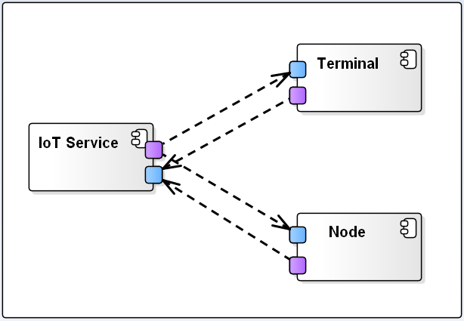
The views – Decomposition #1
Perspective: Dynamic
Element | Responsibilities
Iot Service | Iot Service act as a Server & is responsible to Interact & manage the Clients(Node & Terminal)
Node | Node act as a Client & responsible for Node core operation. It has to process/response Iot Service command
Terminal | Terminal act as a Client & responsible for Terminal core operation. It has to process/response Iot Service command
Rationale | SRP(Single Responsibility Principle) IoT Server, Node and Terminal have a different responsibility The relation between entities is a loose coupling Client-server pattern Easy to add the terminal and node
Alternatives | -
Requirement | -

Slide 62
The views - Switch to physical perspective

Slide 63
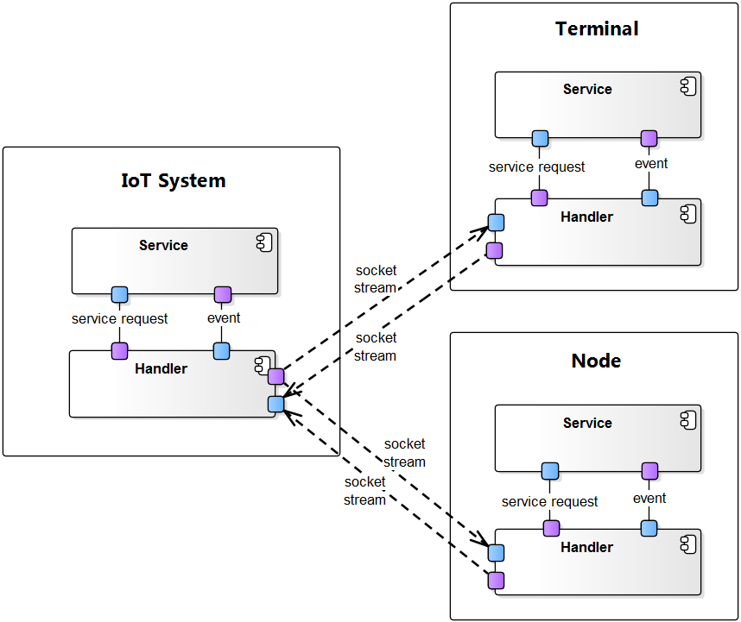
The views – Decomposition #2
Perspective: Dynamic
Element | Responsibilities
Service | Responsible for Process core operation apart from external data communication
Handler | Externally, Handler is responsible for data communication with other device. Internally, Handling the data communication via own defined protocol.
Rationale | Layered pattern The layered pattern is used to serve the restrict dependency Handler is served to 3rd party to develop their application or node easily
Alternatives | -
Requirement | QA6

Slide 64
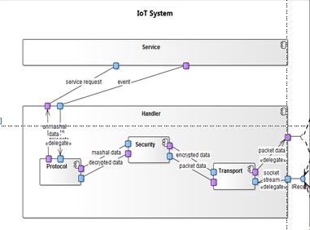
The views – Decomposition #3
Element | Responsibilities
Protocol | This component is responsible formating the message for communication.
Security | This component is responsible for incoming/outgoing data Encoding & Decoding based on project defined Encription Logic.
Transport | This is responsible for making the data external communicaiton with barrier(WIFI, BT etc) independent & loose couple
Rationale | Pipe & Filter Each filter has a responsibility The filter can replace easily(strong security, data stream type change etc)
Alternatives | -
Requirement | QA3. QA7

Slide 65
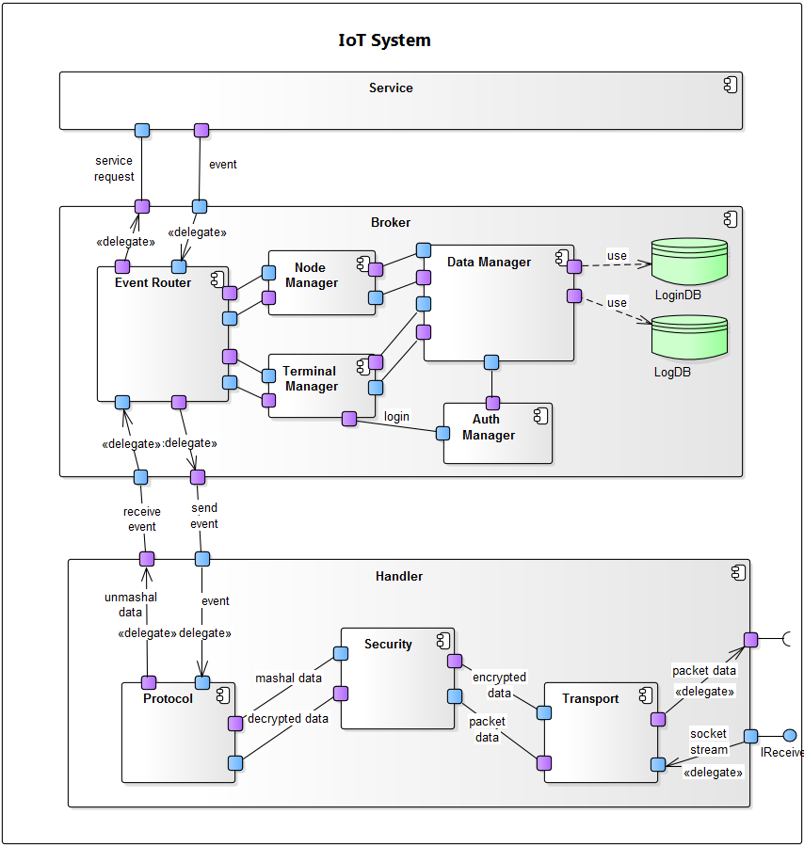
The views – Decomposition #4
Rationale | Broker pattern Divide the message from terminal and node to responsibility component
Alternatives | Publish-subscribe pattern
Requirement
Element | Responsibilities
Broker
Node manager
Terminal manager

Slide 66
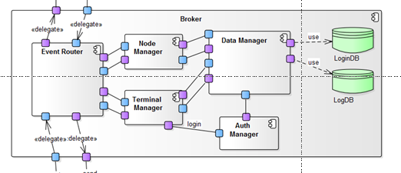
The views – Decomposition #5
Element | Responsibilities
Data Manager
Auto Manager
LogDB
Login DB
Handler
Rationale | SRP(Single Responsibility Principle)
Alternatives | -
Requirement | QA3, QA5

Slide 67
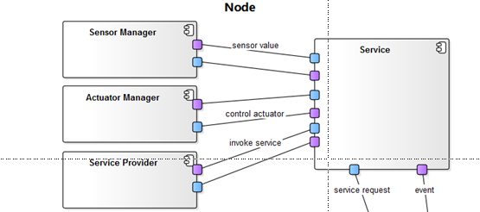
The views – Node decomposition
Element | Responsibilities
Sensor Manager
Acturator Manager
Service provider
Service
Handler
Rationale | SRP(Single Responsibility Principle)
Alternatives | -
Requirement

Slide 68
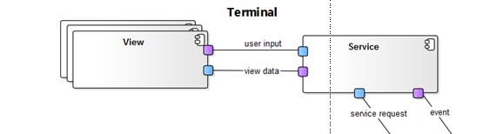
The views – Terminal decomposition
Element | Responsibilities
View
Service
Handler
Rationale | MVC
Alternatives | -
Requirement

Slide 69
The views – Terminal decomposition
Element | Responsibilities
View
Service
Handler
Rationale | MVC
Alternatives | -
Requirement

Slide 70
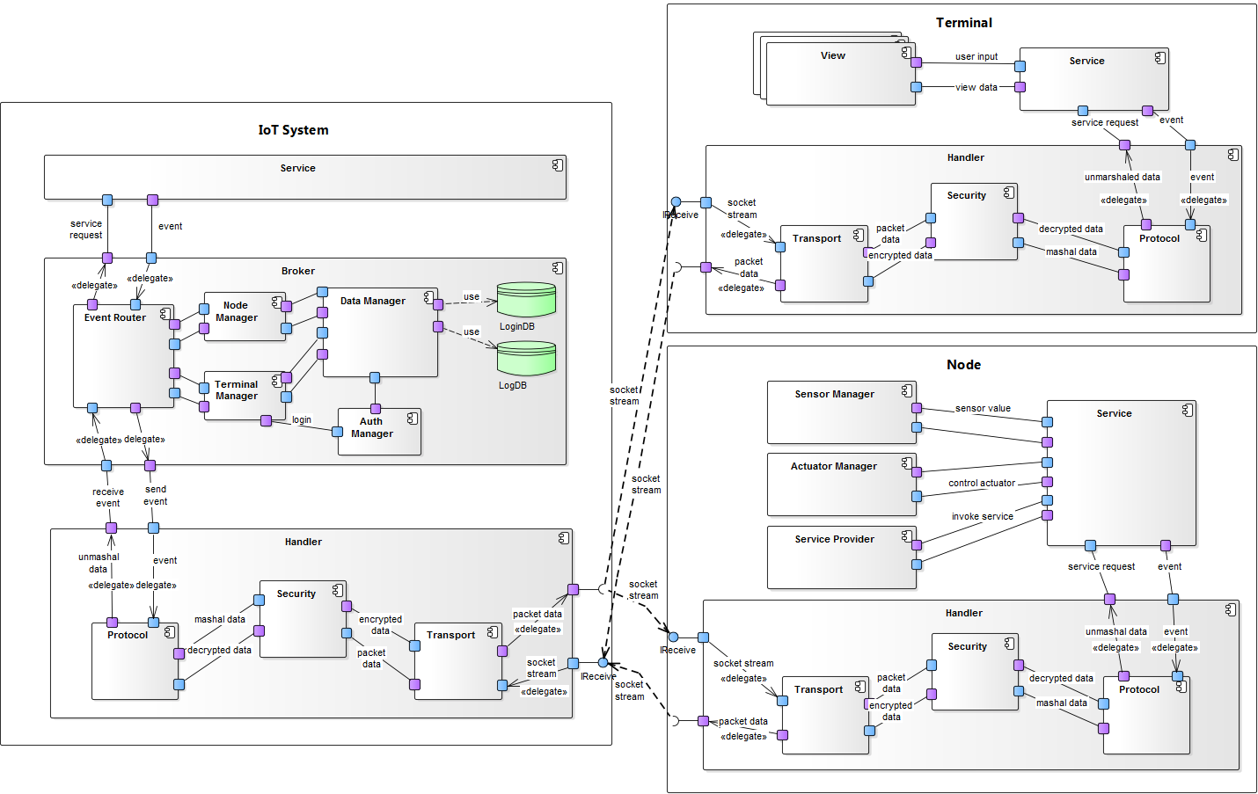
The views

Slide 71
The views – switch to physical

Slide 72

The views – switch to static view

